Slide 1


P3：非监督学习
机器学习工程师vip班
By 助教Steven

Slide 2

目录
知识点整理
Q&A

Slide 3
知识点整理
K-均值聚类
层次聚类法
密度聚类
高斯混合聚类

Slide 4
知识点整理：K-Means Clustering
NP难问题： https://www.zhihu.com/question/27039635

Slide 5
知识点整理：K-Means Clustering

Slide 6
知识点整理：K-Means Clustering
假设有6个点:
x1: (0, 0), x2:(1, 0), x3:(1, 1), x4:(2, 1), x5:(3, 1), x6:(3, 0)
设 k=2, 初始均值为 μ1(0, 0) 和 μ2(2, 1)
用K-Means来聚类
Cluster 1: {x1:(0,0) }
Cluster 2: {x4:(2,1)}

Slide 7
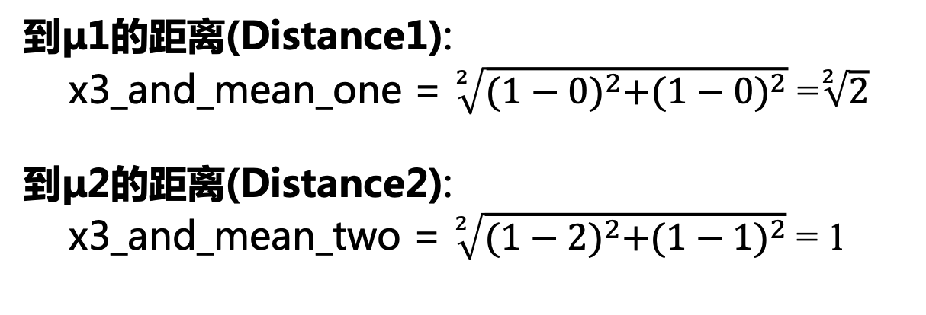
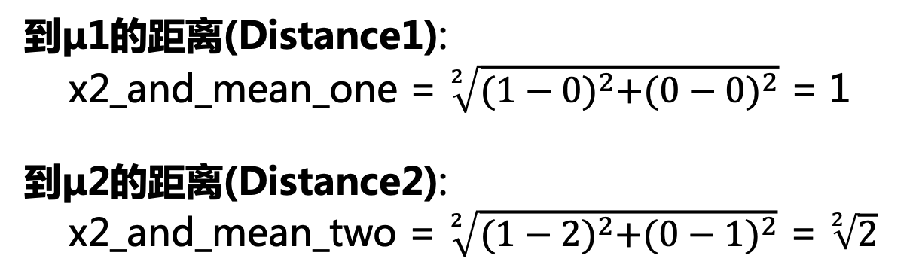
知识点整理：K-Means Clustering
x2: (1, 0)
x3: (1, 1)
到μ1的距离(Distance1):
x2_and_mean_one = $\sqrt[2]{{(1−0)}^{2}+{(0−0)}^{2}}$ = 1
到μ2的距离(Distance2):
x2_and_mean_two = $\sqrt[2]{{(1−2)}^{2}+{(0−1)}^{2}}$ = $\sqrt[2]{2}$
到μ1的距离(Distance1):
x3_and_mean_one = $\sqrt[2]{{(1−0)}^{2}+{(1−0)}^{2}}$ =$\sqrt[2]{2}$
到μ2的距离(Distance2):
x3_and_mean_two = $\sqrt[2]{{(1−2)}^{2}+{(1−1)}^{2}}$ = 1
Distance1 < Distance2, 所以x2 距离μ1更近
Distance1 > Distance2, 所以x3 距离μ2更近
Cluster 1: {x1:(0,0) , x2:(1,0)}
Cluster 2: {x4:(2,1)}
Cluster 1: {x1:(0,0) , x2:(1,0)}
Cluster 2: {x4:(2,1) , x3:(1,1)}

Slide 8
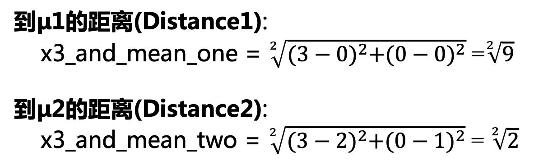
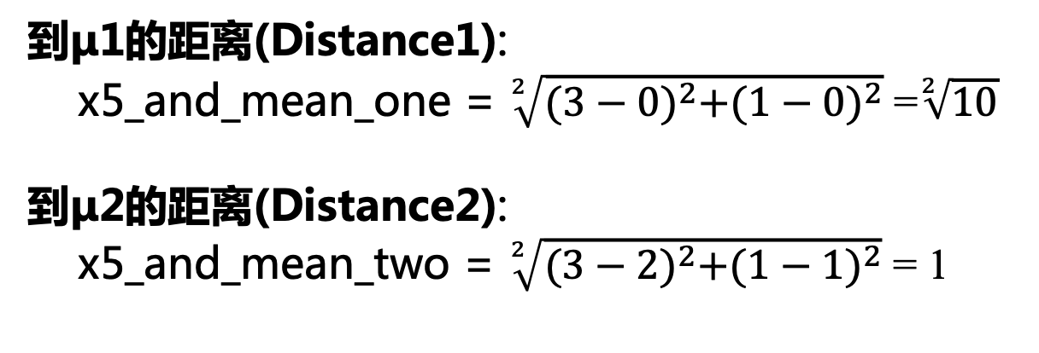
知识点整理：K-Means Clustering
x5: (3, 1)
x6: (3, 0)
到μ1的距离(Distance1):
x5_and_mean_one = $\sqrt[2]{{(3−0)}^{2}+{(1−0)}^{2}}$ =$\sqrt[2]{10}$
到μ2的距离(Distance2):
x5_and_mean_two = $\sqrt[2]{{(3−2)}^{2}+{(1−1)}^{2}}$ = 1
到μ1的距离(Distance1):
x3_and_mean_one = $\sqrt[2]{{(3−0)}^{2}+{(0−0)}^{2}}$ =$\sqrt[2]{9}$
到μ2的距离(Distance2):
x3_and_mean_two = $\sqrt[2]{{(3−2)}^{2}+{(0−1)}^{2}}$ = $\sqrt[2]{2}$
Distance1 > Distance2, 所以x5 距离μ2更近
Distance1 > Distance2, 所以x6 距离μ2更近
Cluster 1: {x1:(0,0) , x2:(1,0)}
Cluster 2: {x4:(2,1) , x3:(1,1) , x5:(3,1)}
Cluster 1: {x1:(0,0) , x2:(1,0)}
Cluster 2: {x4:(2,1) , x3:(1,1) , x5:(3,1) , x6:(3,0)}

Slide 9
知识点整理：K-Means Clustering
Cluster 1:
x1:(0,0) , x2:(1,0)
Cluster 2:
x3:(1,1) , x4:(2,1) , x5:(3,1) , x6:(3,0)
μ1:
μ1 = ((0+1)/2, (0+0)/2) = (0.5, 0)
μ2:
μ2 = ((1+2+3+3)/4, (1+1+1+0)/4) = (2.25, 0.75)
重复刚才的步骤来重新计算各点与新平均点的距离，并分到对应的聚类

Slide 10
知识点整理：K-Means Clustering
μ1 = (0.667, 0.33)
μ2 = (2.67, 0.33)
经过n次迭代之后，发现无论怎么重新计算，μ1和μ2的值都不会改变了，即已经收敛，无法继续更新了
所以最后结果：
Cluster 1:
x1:(0,0) , x2:(1,0) , x3:(1,1)
Cluster 2:
x4:(2,1) , x5:(3,1) , x6:(3,0)

Slide 11
知识点整理：K-Means Clustering

Slide 12
知识点整理：Hierarchical Clustering
Single link：
Complete link：
Average link：

Slide 13
知识点整理：Hierarchical Clustering

Slide 14
知识点整理：Hierarchical Clustering
Find the smallest value, merge them
1
2
3
4
5
1
(12)
3
4
5
2
(12)
3
3
4
4
5
5
Update Distance
Dendrogram
2
1
5.0
4.0
3.0
2.0
1.0
0
Distance

Slide 15
知识点整理：Hierarchical Clustering
1 and 2 as a whole
(12)
3
4
5
(12)
3
4
5
Dendrogram
2
1
5.0
4.0
3.0
2.0
1.0
0
Distance

Slide 16
知识点整理：Hierarchical Clustering
Repeat:
Find the smallest value, merge them
(12)
3
4
5
(12)
3
(4 5)
(12)
(12)
3
3
4
(4 5)
5
Dendrogram
5
4
2
1
5.0
4.0
3.0
2.0
1.0
0
Distance

Slide 17
知识点整理：Hierarchical Clustering
Repeat:
Find the smallest value, merge them
(12)
3
(4 5)
(12)
(12)
(3 4 5)
(12)
3
(3 4 5)
(4 5)
Dendrogram
5
4
3
2
1
5.0
4.0
3.0
2.0
1.0
0
Distance

Slide 18
知识点整理：Hierarchical Clustering
Repeat:
Find the smallest value, merge them
(12)
(3 4 5)
(12)
(3 4 5)
Dendrogram
5
4
3
2
1
5.0
4.0
3.0
2.0
1.0
0
Distance

Slide 19
知识点整理：Density-Based Clustering

Slide 20
知识点整理：Density-Based Clustering

Slide 21
知识点整理：Density-Based Clustering

Slide 22
知识点整理：Density-Based Clustering
A point is a core point if it has more than a specified number of points (MinPts) within Epsilon
These are points that are at the interior of a cluster
A border point has fewer than MinPts within Eps, but is in the neighborhood of a core point

Slide 23
知识点整理：Density-Based Clustering
DBSCAN: The Algorithm
Arbitrary select a point p (随机选择一个点p)
Retrieve all points density-reachable from p w.r.t. Eps and MinPts (对于给定的Epsilon和MinPts的值，找到所有从p可以密度直达的点)
If p is a core point, a cluster is formed (如果p是核心对象，那么就生成了一个以p为核心的聚类)
If p is a border point, no points are density-reachable from p and DBSCAN visits the next point of the database (如果p是边缘点，没有可以从p密度直达的其他点了, 算法继续对数据库的下一个点进行分析)
Continue the process until all of the points have been processed (继续上述过程直到所有点都分析完毕)

Slide 24
知识点整理：Density-Based Clustering
Given a point p and a non-negative real number ε,
the ε-neighborhood of point p, denoted by N(p), is the set of points q (including point p itself) such that the distance between p and q is within ε.
According to ε-neighborhood of point p, we classify all points into three types
core points
border points
noise points
Given a point p and a non-negative integer MinPts, if the size of N(p) is at least MinPts, then p is said to be a core point.
Given a point p, p is said to be a border point if it is not a core point but N(p) contains at least one core point.
Given a point p, p is said to be a noise point if it is neither a core point nor a border point.

Slide 25
知识点整理：Density-Based Clustering
Example
Consider the following 9 two-dimensional data points:
x1(0,0), x2(1,0), x3(1,1), x4(2,2), x5(3,1), x6(3,0), x7(0,1), x8(3,2), x9(6,3)
Use the Euclidean Distance with Eps =1 and MinPts = 3
(Eps is short for epsilon: ε)
Find all core points, border points and noise points, and show the final clusters using DBCSAN algorithm.

Slide 26
知识点整理：Density-Based Clustering
Example

Slide 27
知识点整理：Density-Based Clustering
Example
Eps =1 and MinPts = 3
N(x1) = {x1, x2, x7}
N(x2) = {x2, x1, x3}
N(x3) = {x3, x2, x7}
N(x4) = {x4, x8}
N(x5) = {x5, x6, x8}
N(x6) = {x6, x5}
N(x7) = {x7, x1, x3}
N(x8) = {x8, x4, x5}
N(x9) = {x9}

Slide 28
知识点整理：Density-Based Clustering
Example
If the size of N(p) is at least MinPts, then p is said to be a core point.
Here the given MinPts is 3, thus the size of N(p) is at least 3.
Eps =1 and MinPts = 3
given a point p, p is said to be a border point if it is not a core point but N(p) contains at least one core point.
N(x1) = {x1, x2, x7}
Thus core points are:
{x1, x2, x3, x5, x7, x8}
N(x2) = {x2, x1, x3}
N(x3) = {x3, x2, x7}
N(x4) = {x4, x8}
x4 and x6 are border points.
N(x5) = {x5, x6, x8}
N(x6) = {x6, x5}
N(x7) = {x7, x1, x3}
N(x8) = {x8, x4, x5}
N(x9) = {x9}
x9 is a noise point.

Slide 29
知识点整理：Density-Based Clustering
DBSCAN: The Algorithm
Arbitrary select a point p (随机选择一个点p)
Retrieve all points density-reachable from p w.r.t. Eps and MinPts (对于给定的Epsilon和MinPts的值，找到所有从p可以密度直达的点)
If p is a core point, a cluster is formed (如果p是核心对象，那么就生成了一个以p为核心的聚类)
If p is a border point, no points are density-reachable from p and DBSCAN visits the next point of the database (如果p是边缘点，没有可以从p密度直达的其他点了, 算法继续对数据库的下一个点进行分析)
Continue the process until all of the points have been processed (继续上述过程直到所有点都分析完毕)

Slide 30
知识点整理：Density-Based Clustering
Arbitrary select a point p, now we choose x1
Retrieve all points density-reachable from x1: {x2, x3, x7}
Here x1 is a core point, a cluster is formed.
So we have Cluster_1: {x1, x2, x3, x7}
Next we choose x5,
Retrieve all points density-reachable from x5: {x8, x4, x6}
N(x1) = {x1, x2, x7}
N(x2) = {x2, x1, x3}
N(x3) = {x3, x2, x7}
N(x4) = {x4, x8}
N(x5) = {x5, x6, x8}
N(x6) = {x6, x5}
N(x7) = {x7, x1, x3}
Here x5 is a core point, a cluster is formed.
So we have Cluster_2: {x5, x4, x8, x6}
Next we choose x9, x9 is a noise point, noise points do NOT belong to any clusters.
Thus the algorithm stops here.
N(x8) = {x8, x4, x5}
N(x9) = {x9}

Slide 31
知识点整理：Density-Based Clustering

Slide 32
知识点整理：GMM

Slide 33
知识点整理：GMM

Slide 34
知识点整理：GMM

Slide 35
知识点整理：GMM

Slide 36
知识点整理：GMM

Slide 37
知识点整理：GMM

Slide 38
知识点整理：GMM
Reference: https://blog.csdn.net/jinping_shi/article/details/59613054

Slide 39
Q&A

Slide 40
Thank you

